Slide 1
Technical Documentation on Lab 3 Reproduce (Supply Chain)
Rizqy Eka Putra Rizaldy
School of Electrical Engineering
Department of Computer Engineering
1103184149

Slide 2
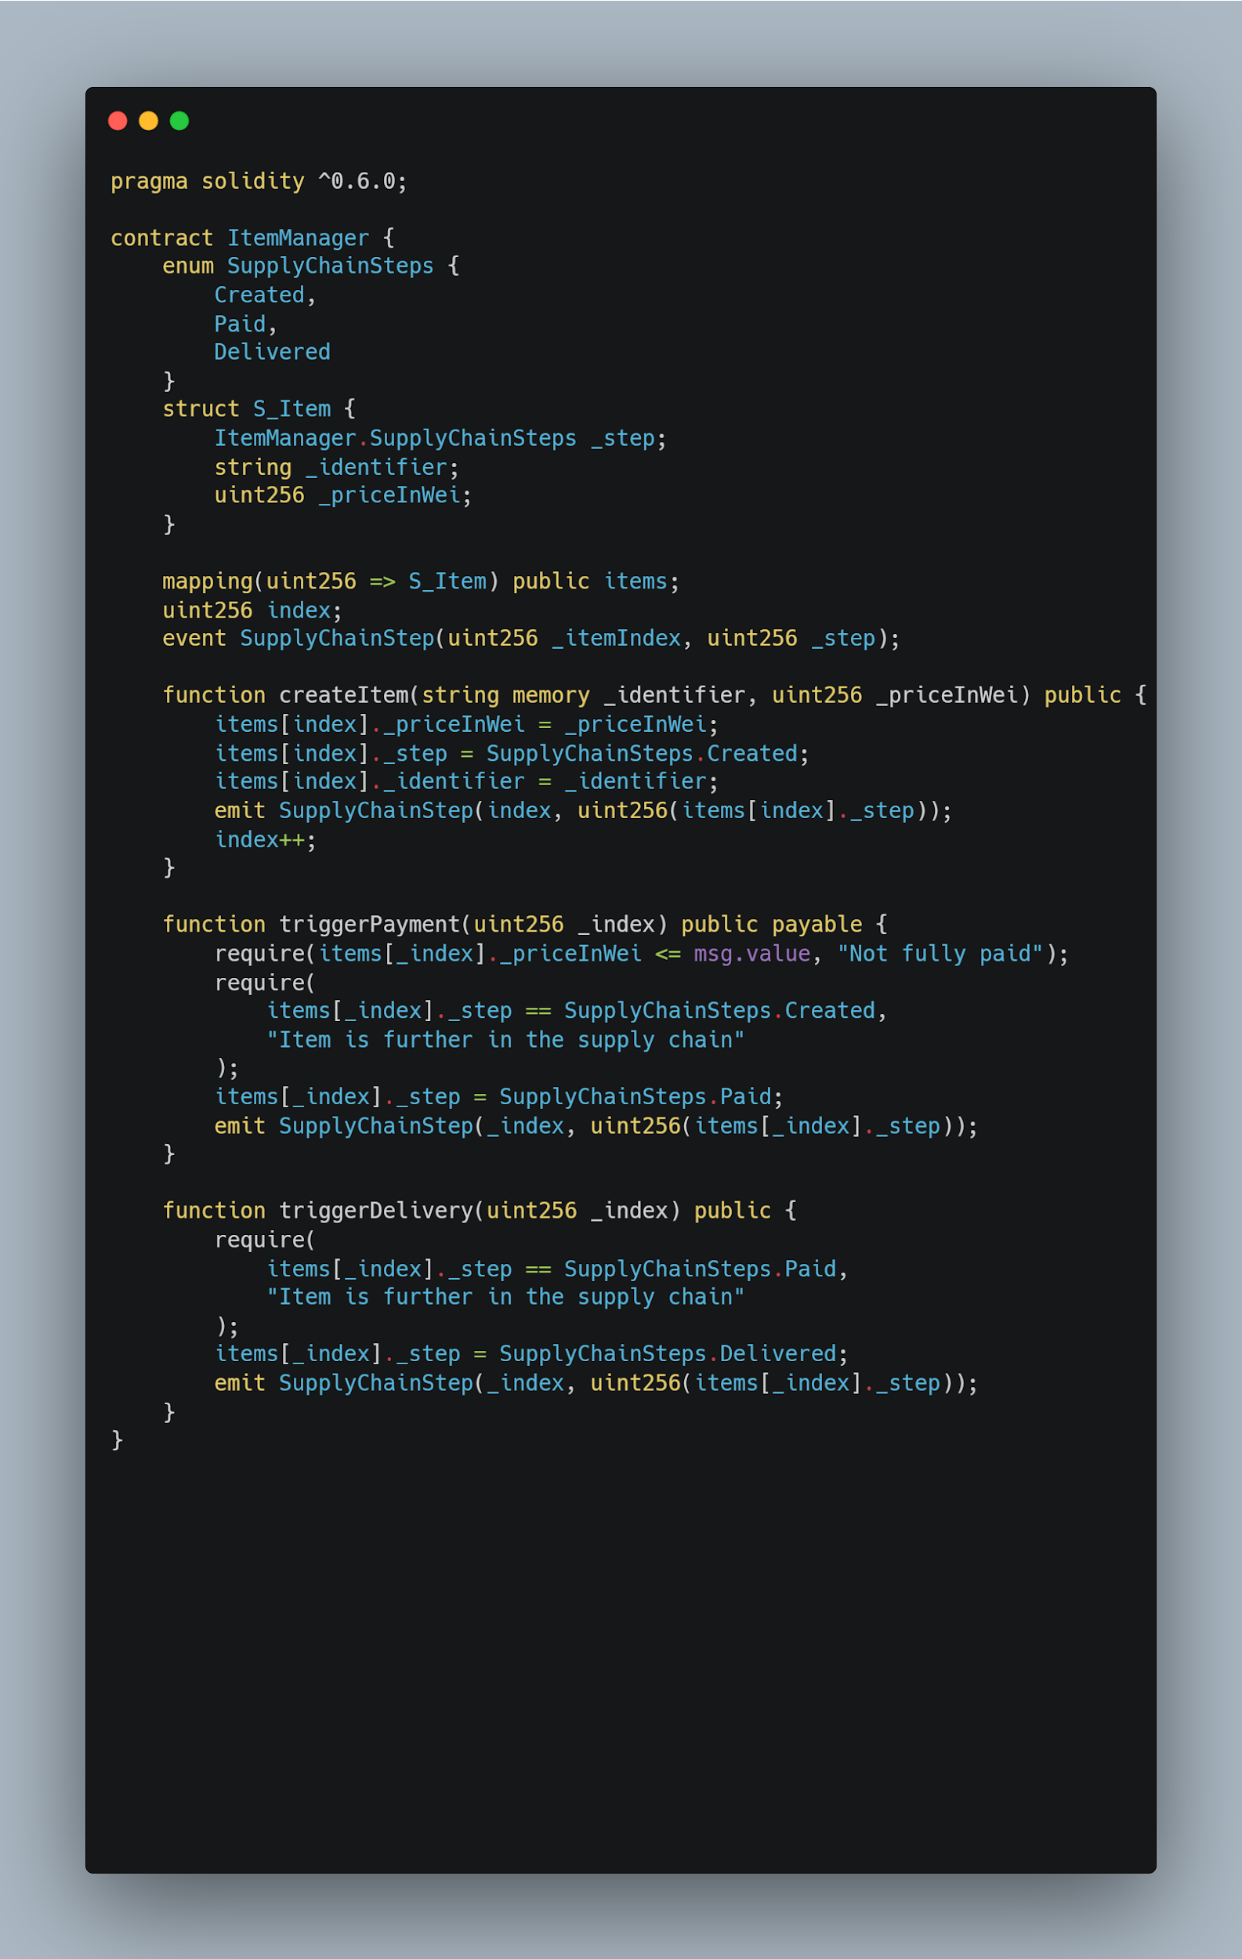
The ItemManager Smart Contract
The first thing we need is a "Management" Smart Contract, where we can add items.

Slide 3
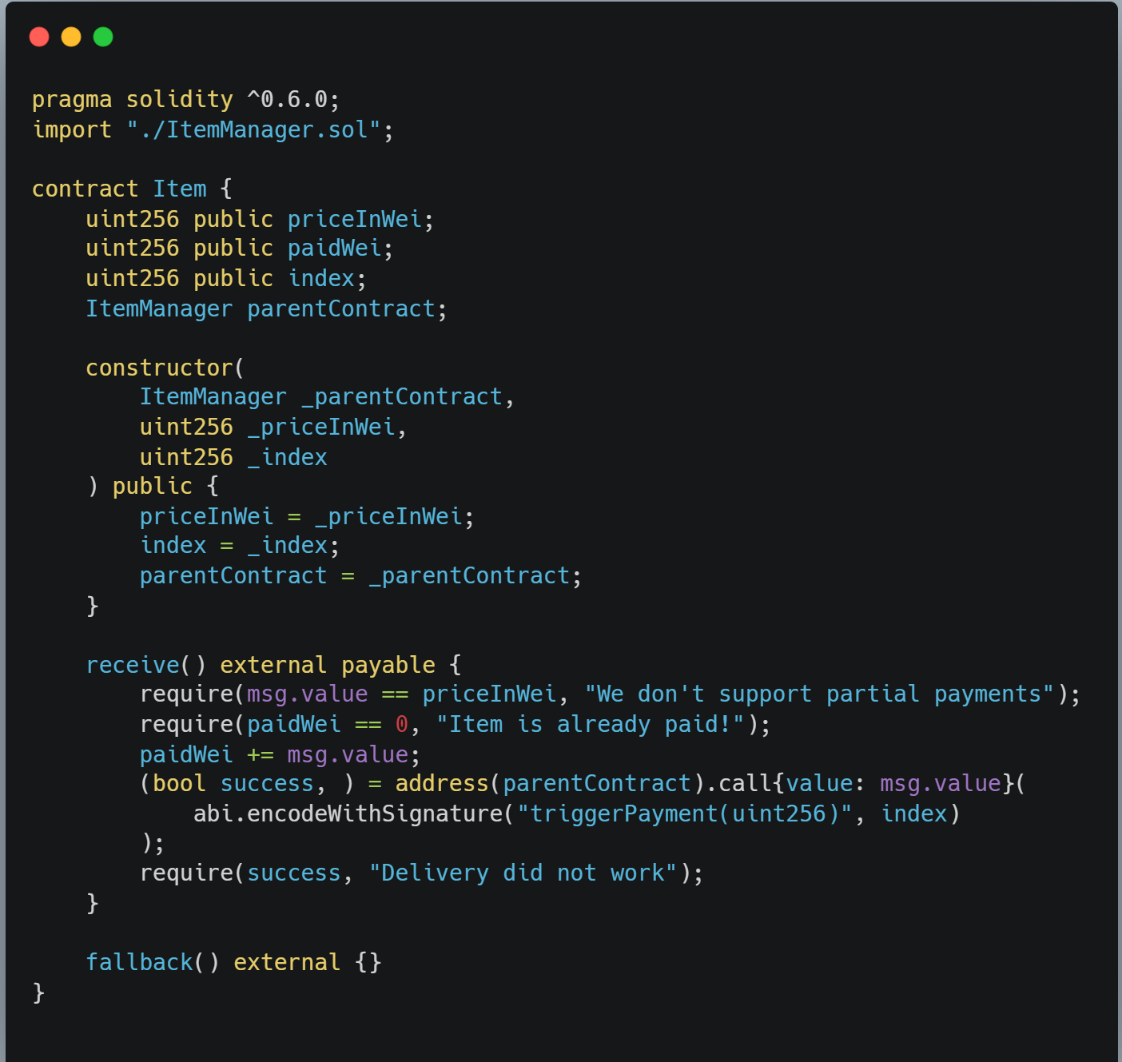
Item Smart Contract

Slide 4
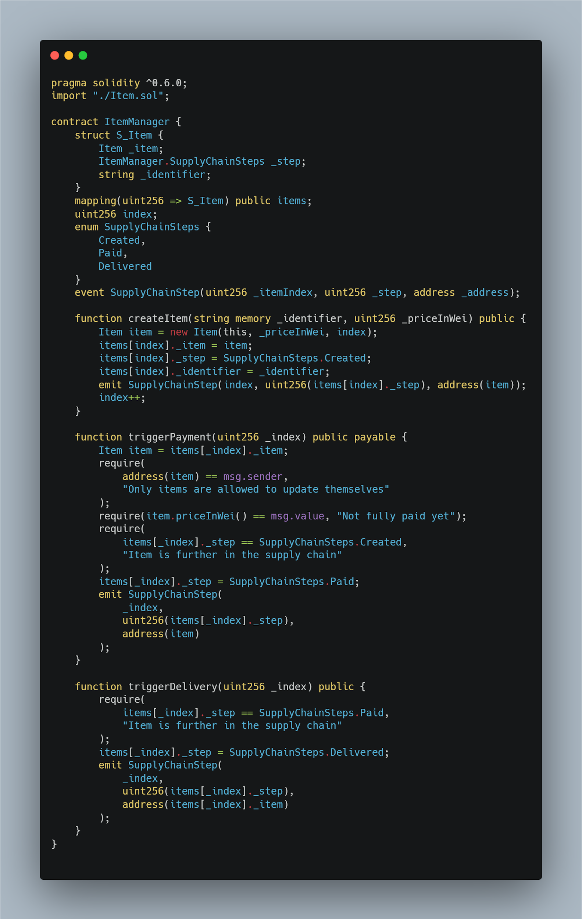
ItemManager Changes
And change the ItemManager Smart Contract to use the Item Smart Contract instead of the Struct only:

Slide 5
Now with this we just have to give a customer the address of the Item Smart Contract created during "createItem" and he
will be able to pay directly by sending X Wei to the Smart Contract. But the smart contract isn't very secure yet. We need
some sort of owner functionality.

Slide 6
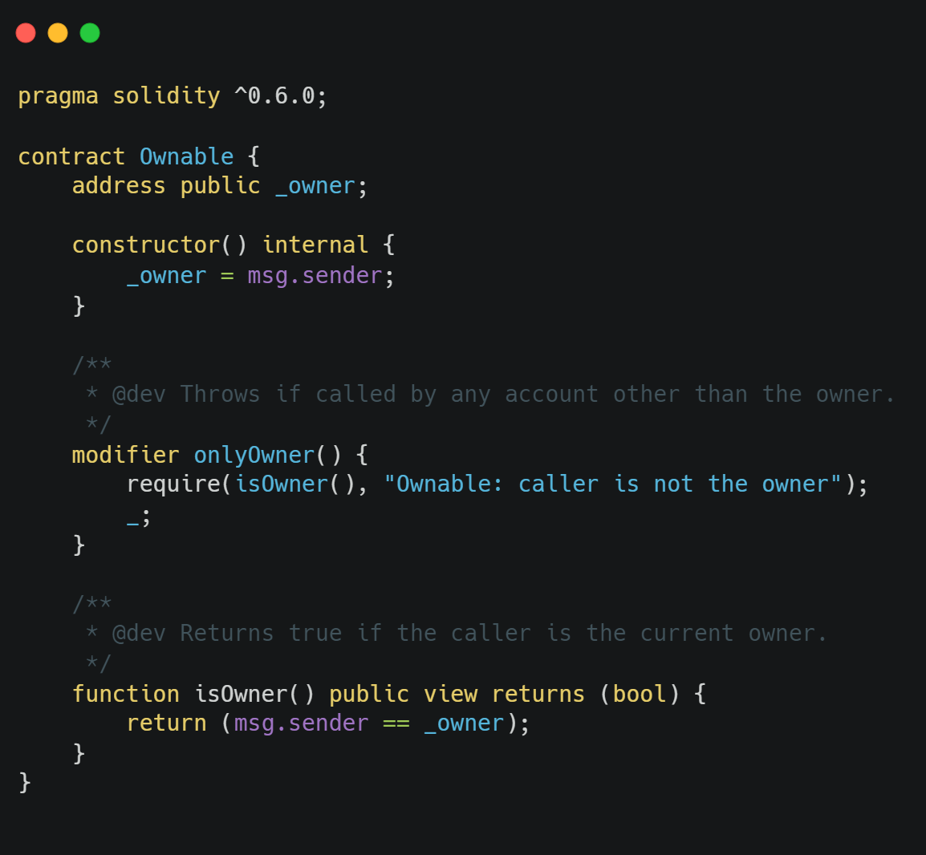
Ownable Functionality
On this section we will implement our own Ownable function instead of using OpenZeppelin’s

Slide 7
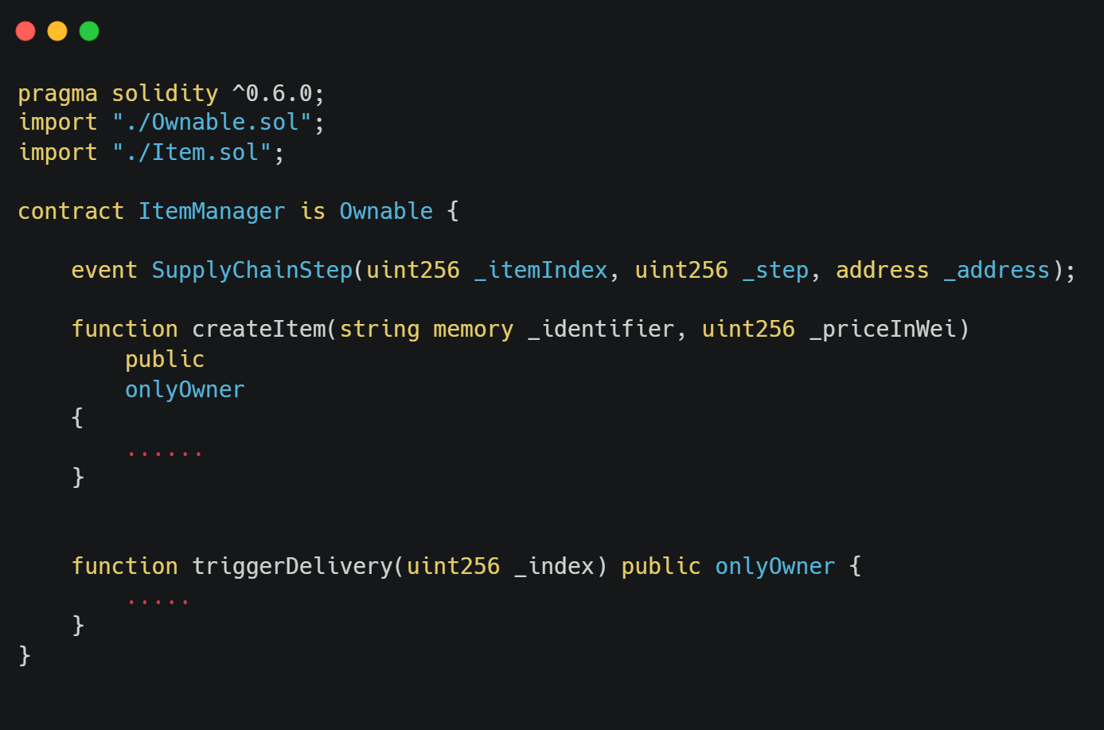
Implement Ownable
Apply Ownable contract to ItemManager so that all function that should only executable by its owner
Only , has correct modifier (see highlighted code)

Slide 8
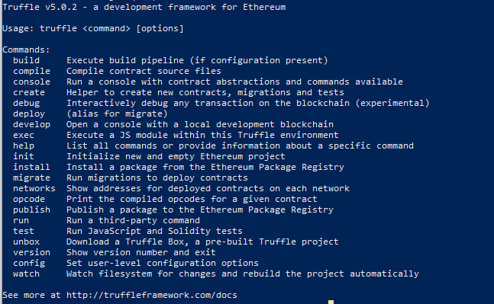
Install Truffle
The next step is to install truffle with this command : (make sure you have node and npm installed)
- npm install –g truffle (-g flag is to install it globally on your system)

Slide 9
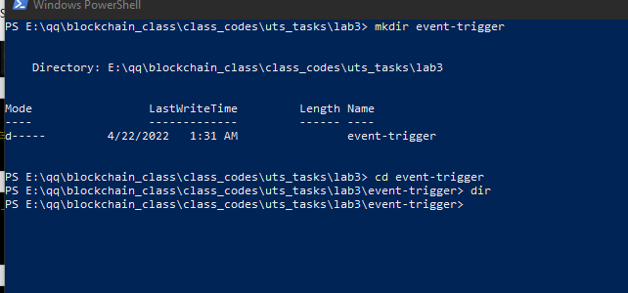
Init Directory for Event Trigger
Create a new directory via your terminal ( I named it event-trigger) command : mkdir event-trigger
Change your directory to the created directory , command : cd event-trigger

Slide 10
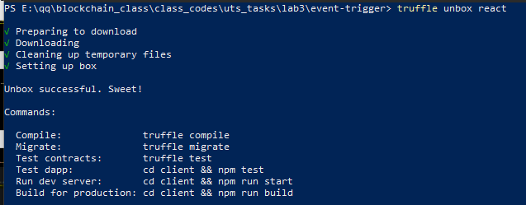
Truffle React Box
Unbox the truffle react box with command below :
truffle unbox react
After a successfull unbox of react you’ll see a result as shown below

Slide 11
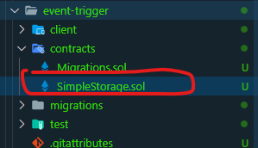
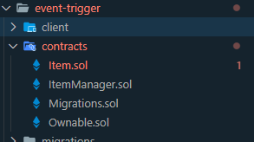
Remove Basic Contract , Add our Contract files
After a successfull unbox of react , you’ll get various files, but in the “contracts” directory you’ll need to remove
the SimpleStorage.sol, and later insert our contracts to the “contracts” directory as shown below
Add Contracts that we have created before
Remove This

Slide 12
Modify Migration And Configuration File
Modify the "migration" file in the migrations/ folder as shown below,
It’s located on : migrations/2_deploy_contracts.js
var ItemManager = artifacts.require("./ItemManager.sol");
module.exports = function(deployer) {
deployer.deploy(ItemManager);
};
Next , Modify the “truffle.config.js" file as shown below,

Slide 13
Modify Migration And Configuration File
Next , Modify the “truffle.config.js" file as shown below, see highlighted (green-like) code for the major changes
const path = require("path");
module.exports = {
// See <http://truffleframework.com/docs/advanced/configuration>
// to customize your Truffle configuration!
contracts_build_directory: path.join(__dirname, "client/src/contracts"),
networks: {
develop: {
port: 8545
}
},
compilers: {
solc: {
version: "^0.6.0“
}
}
};

Slide 14
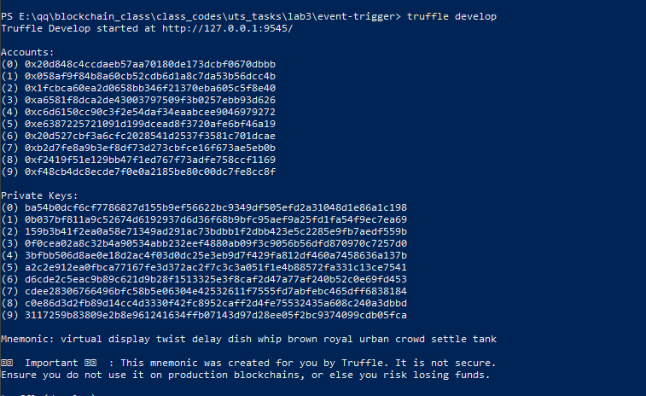
Test and Migrate with Truffle
On the event-trigger directory, run truffle develop command
to make sure everything run smoothly , if nothing goes wrong ,
after that , run “migrate” , and now your smart contract should already been migrated.

Slide 15
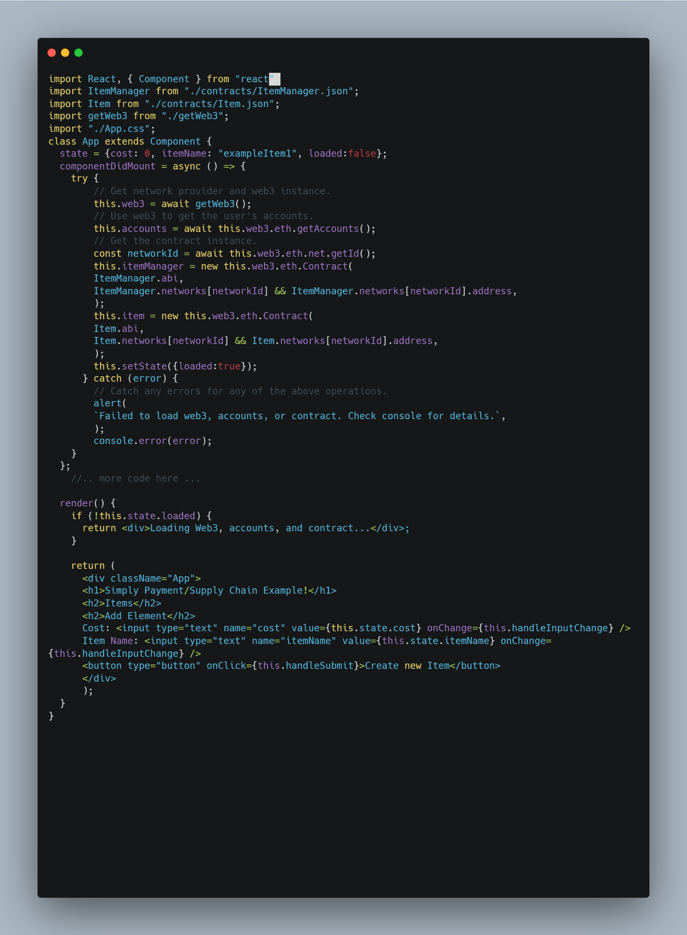
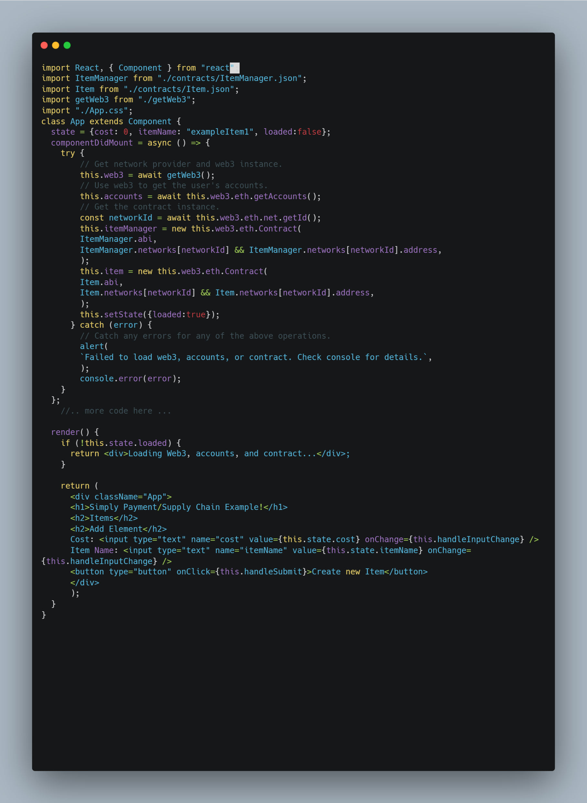
Modifying the Client-Side Code
Now it's time that we modify our HTML so we can actually interact with the Smart Contract from the Browser.
Open "client/App.js" and modify a few things inside the file:

Slide 16
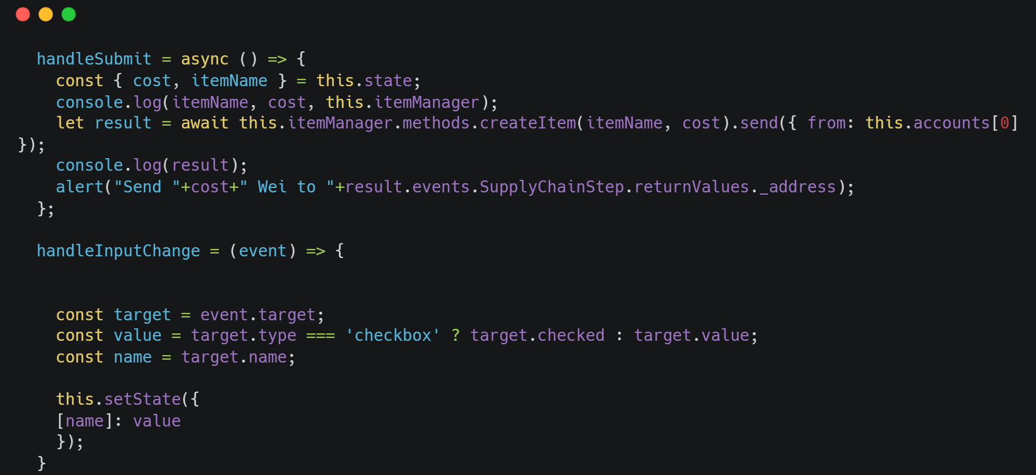
Modifying the Client-Side Code
And then on the part that commented “//More code here …” add these code :

Slide 17
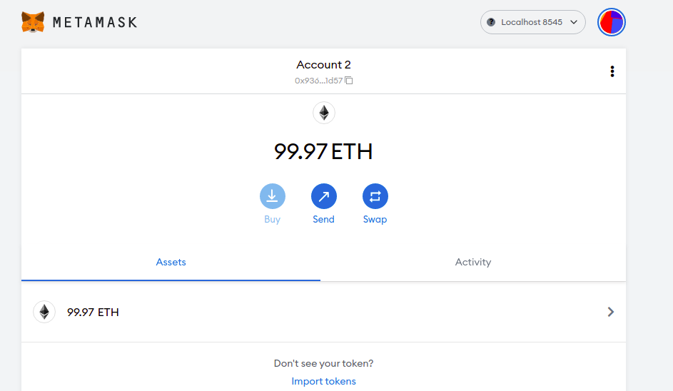
Connect Wallet and Interact with Smart Contract
Navigate to “/client” directory and run : npm start
You’ll be prompted a MetaMask account, enter your password and connect the wallet, make sure you pick the localhost network that are already running on the “truffle develop” command before

Slide 18
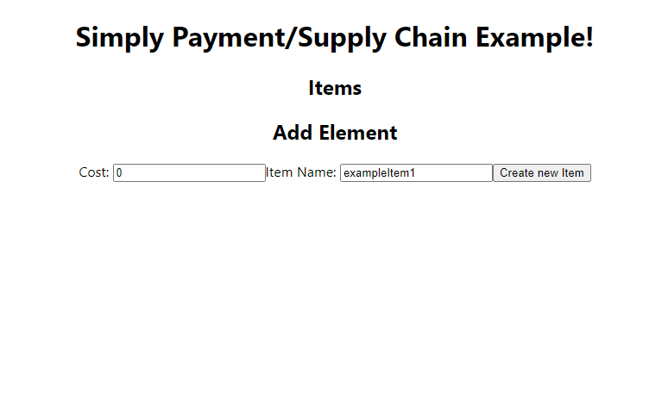
Interact with the Smart Contract
Navigate to “/client” directory and run : npm start
You’ll be prompted a MetaMask account, enter your password and connect the wallet, after that you should see a client facing website like this :

Slide 19
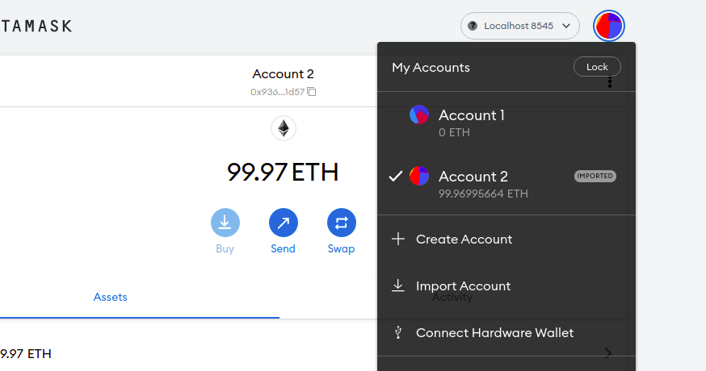
Interact with the Smart Contract
After that , import your account by clicking the account circle on the top right hand side , and
choose import account

Slide 20
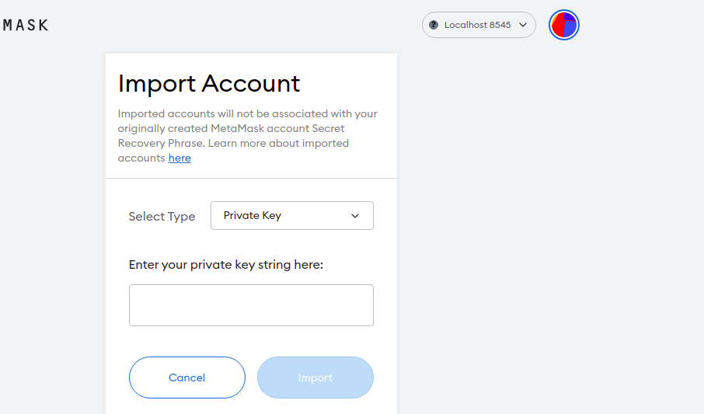
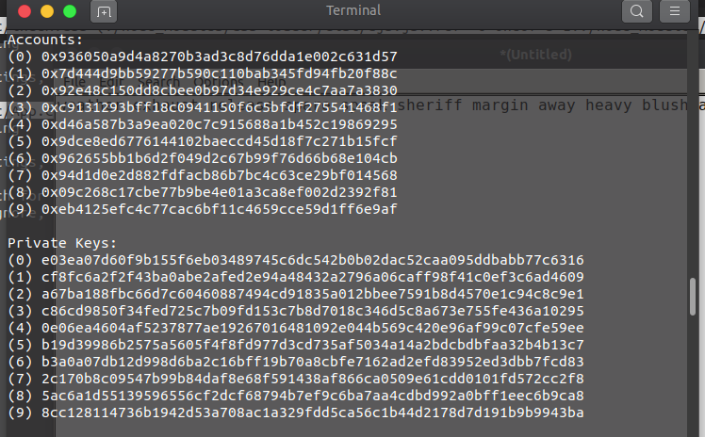
Insert it into metamask import account menu
Get Private Key from your running truffle develop terminal
*Terminal is different from previous Screenshots because i have to switch to linux environment to run truffle due to truffle crashing on windows

Slide 21
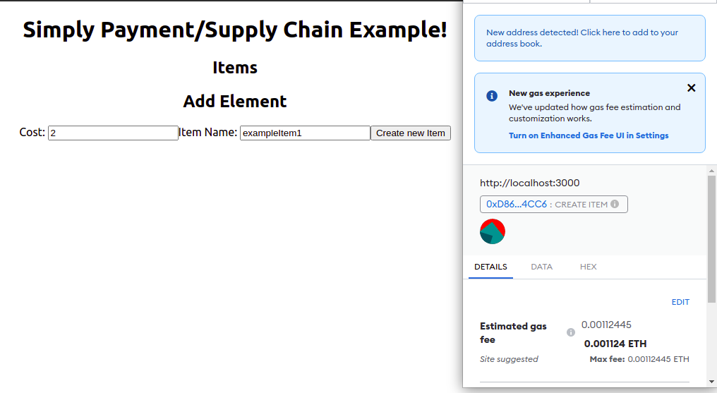
Interact with the Smart Contract
Finally , you could proceed into the client-side interface and start doing transaction by setting the
cost , upon transaction , a metamask pop up will appear to confirm the transaction , along with the
details

Slide 22
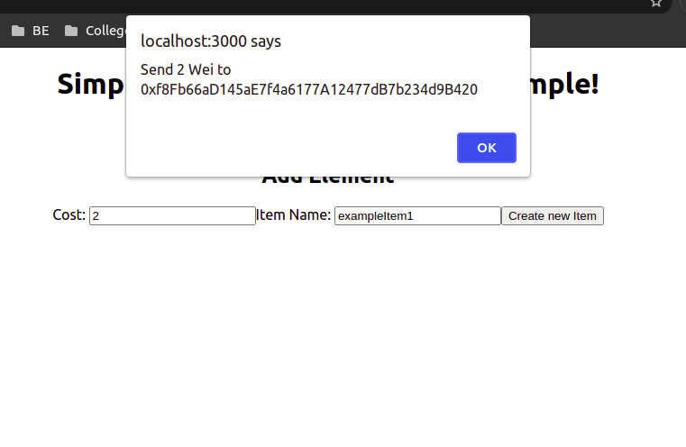
Interact with the Smart Contract
After you confirm the transaction , a pop up will show up , notifying you how many “Wei”s you have
successfully send, for example on this picture below i am filling the cost section with the value of “2”

Slide 23
Lab Done
And that is the example of applying blockchain on a simple supply-chain application!

